Slide 1
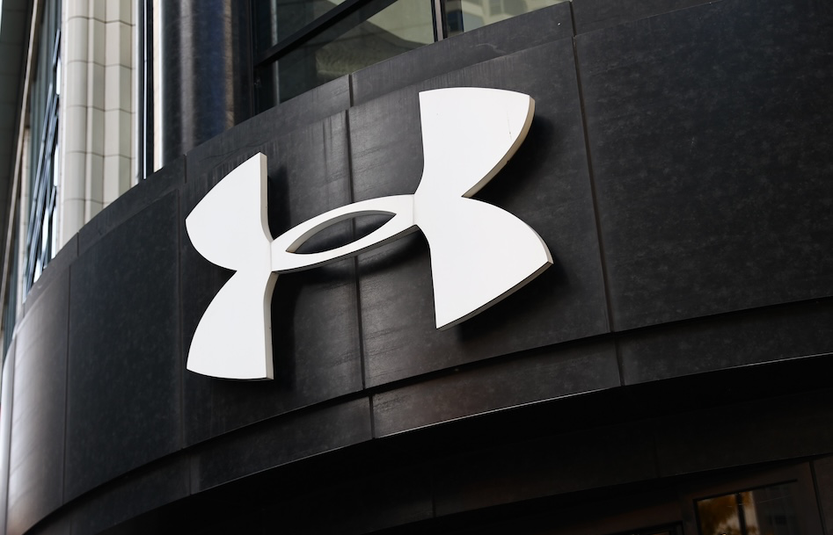
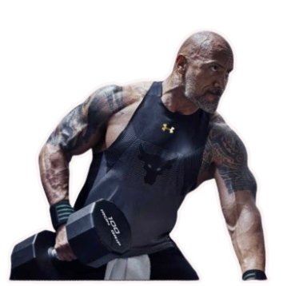
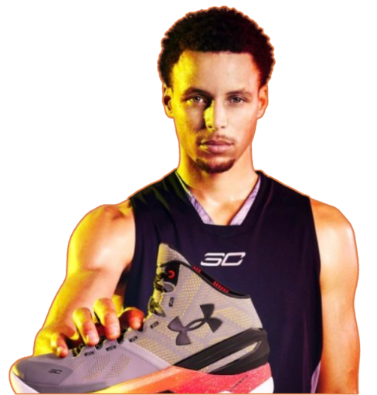
Group 4 Aman Isha Khushboo Pranav Rezoon
____________________________________________________________________________________________________
REIMAGINING UNDER ARMOUR’S
STRATEGY WITH
PREDICTIVE ANALTYICS &
ADAPTIVE TECHNOLOGY
AN INNOVATIVE
APPROACH TO
PERSONALIZATION &
PERFORMANCE
1

Slide 2
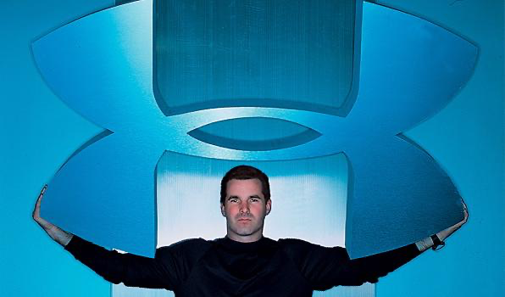
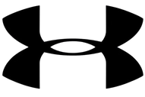
Under Armour is a prominent American sports equipment company that has demonstrated significant innovation in the athletic apparel and footwear industry. Founded in 1996 by Kevin Plank, Under Armour has consistently pushed the boundaries of performance wear technology and design.
Sales Growth and Strategic Investments
In recent years, Under Armour’s focus has been on stabilizing revenue through strategic cost-saving initiatives and technology-driven innovation. Iso-Chill has been a key product in maintaining differentiation within the competitive landscape, offering static cooling solutions for athletes in hot conditions.
However, the introduction of adaptive fabric technology could revolutionize this space, addressing limitations in Iso-Chill by providing real-time dynamic responsiveness. This innovative leap aligns with the company’s push to strengthen its market position.
Year’s Revenue and Market Share
• 2024 Revenue: Under Armour reported net revenues of approximately $5.64 billion in the past 12 months, reflecting steady performance amidst a challenging market.
2

Slide 3
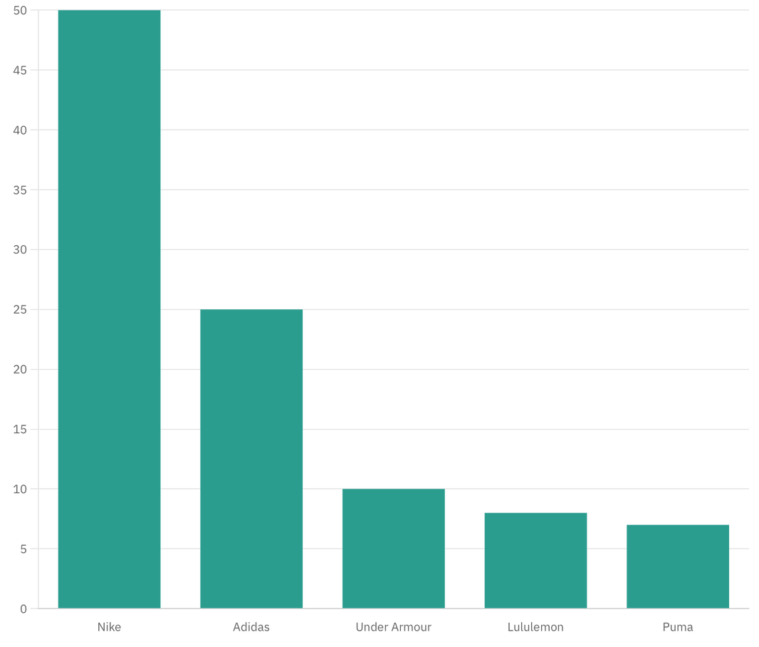
DIRECT COMPETITORS IN PERFORMANCE INNOVATION
Under Armour competes with major brands also focusing on performance-enhancing materials and innovation:
• Nike: Leverages data and advanced materials, integrating technologies like Flyknit and React Foam into their products.
• Adidas: Innovates with technologies like Climacool for temperature regulation and Futurecraft for 3D-printed, sustainable footwear.
• Lululemon: Specializes in sweat-wicking and anti-chafe fabrics, targeting fitness-focused consumers.
• Puma: Focuses on athletic wear with breathable, lightweight materials.
50%
25%
10%
8%
7%
3

Slide 4
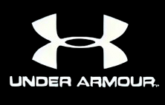
INTRODUCTION TO PREDICTIVE ANALYTICS
Predictive analytics is a branch of advanced analytics that uses historical data, statistical algorithms, machine learning, and artificial intelligence (AI) to identify patterns and predict future outcomes. It provides actionable insights by anticipating trends, behaviors, or events based on past and current data.
Data → Analytics → Decisions → Innovation
Why Use Predictive Analytics?
1. Better Decision-Making: Predictive analytics helps organizations make data-driven decisions by anticipating future events, such as customer demand, financial risks, or operational challenges.
2. Improved Efficiency: Businesses can optimize operations, reduce waste, and allocate resources more effectively, such as predicting inventory needs or scheduling maintenance.
3. Enhanced Customer Experience: Personalizing products, services, and marketing efforts based on customer preferences and behaviors.
4. Competitive Advantage: Staying ahead of competitors by forecasting trends and proactively addressing market demands.
5. Cost Savings: Avoiding costly mistakes by identifying potential risks or inefficiencies early.
4

Slide 5
Nike
Adidas
Under Armour
Technology Focus
Acquired Celect for inventory optimization and Zodiac for customer behavior prediction.
Built in-house forecasting engine for long-term sales prediction and category insights.
Relies on MyFitnessPal and MapMyFitness data to develop real-time adaptive fabric innovations.
Personalization
Tailors recommendations via Nike+ apps based on user activity and preferences.
Offers personalized digital experiences and uses speedfactory for localized manufacturing.
Provides real-time fabric adjustments and personalized suggestions via connected apps.
Inventory Optimization
Predicts demand for limited-edition products, ensuring exclusivity and sell-through rates.
Forecasts demand for adaptive fabrics, ensuring timely production and minimizing waste.
Hyper-local demand prediction minimizes overstock and markdowns.
Sustainability
Leverages lifecycle data for sustainable product innovation, like Futurecraft Loop.
Plans for durable, recyclable adaptive fabrics to meet sustainability goals.
Focused on material efficiency through Flyknit and predictive manufacturing.
Customer-Centric Approach
Prioritizes customer retention and loyalty with data-driven engagement.
Emphasizes localized trends and regional preferences to drive engagement.
Deepens engagement by integrating fitness data for tailored gear and feedback loops.
5
Notes:
Nike
Technology Focus
Nike invests heavily in technology to enhance both product design and user experiences. Tools like Flyknit—a material innovation—combine performance with sustainability by using less waste during production. Additionally, Nike+ apps serve as a digital bridge between the brand and its customers, collecting valuable data to refine its offerings.
Personalization
Nike uses data-driven insights from its Nike+ apps to tailor recommendations based on user activity, preferences, and goals. Whether for casual runners or elite athletes, this ensures every customer receives products and suggestions uniquely suited to their needs.
Inventory Optimization
The acquisition of Celect has revolutionized Nike’s inventory management. By leveraging hyper-local demand predictions, Nike ensures that its stock levels align with customer demand in specific regions, reducing markdowns and avoiding overstock situations.
Sustainability
Nike places a strong emphasis on sustainability, evident in its Flyknit technology. By focusing on material efficiency and waste reduction during production, Nike integrates eco-conscious practices into its core business operations. Predictive modeling helps minimize resource usage while maintaining performance standards.
Customer-Centric Approach
Customer retention and loyalty are key pillars of Nike’s strategy. The brand uses data analytics to create tailored, engaging experiences that deepen customer relationships. Loyalty programs and fitness tracking through Nike apps enhance this engagement, ensuring sustained connections with its audience.
Adidas
Technology Focus
Adidas incorporates cutting-edge technology like Speedfactory to enable localized and efficient manufacturing. Its focus on digital consumer engagement further strengthens its position as a tech-forward brand.
Personalization
Adidas delivers highly personalized digital experiences, utilizing consumer data to tailor products and marketing efforts. Its strategies include offering customizable options and aligning product designs with regional and demographic trends.
Inventory Optimization
Adidas employs predictive analytics to manage inventory effectively, especially for limited-edition products. This ensures exclusivity while maintaining optimal stock levels to maximize profitability and customer satisfaction.
Sustainability
The brand emphasizes sustainable innovation, as demonstrated by initiatives like Futurecraft Loop—a fully recyclable shoe that underscores Adidas’s commitment to circular product design. Lifecycle data informs material choices, reducing environmental impact.
Customer-Centric Approach
Adidas prioritizes engaging consumers through localized trends and regional preferences. This ensures its offerings resonate with different markets, enhancing brand relevance and loyalty.
Under Armour
Technology Focus
Under Armour integrates data from fitness apps like MyFitnessPal and MapMyFitness into its operations to drive innovation. This data forms the foundation for its adaptive fabric technology, enabling products to respond in real time to consumer needs.
Personalization
By analyzing fitness data, Under Armour provides personalized product recommendations and real-time adjustments in gear. This creates a hyper-customized experience for athletes, enhancing both performance and engagement.
Inventory Optimization
Predictive analytics helps Under Armour forecast demand for adaptive fabrics, ensuring production aligns with seasonal and regional requirements. This minimizes waste, reduces overstock, and optimizes resource allocation.
Sustainability
Under Armour is committed to developing durable and recyclable adaptive fabrics, reducing environmental impact and aligning with eco-conscious consumer expectations. This effort combines innovation with sustainability goals to meet long-term objectives.
Customer-Centric Approach
Under Armour deepens customer engagement by integrating fitness and lifestyle data into its gear development. Feedback loops allow the brand to refine products continuously, ensuring they meet and exceed customer expectations.

Slide 6
ADAPTIVE FABRIC OVERVIEW (1/2)
Feature
Iso-Chill
Adaptive Fabric
Provides passive cooling to keep muscles cool, but does not assist with heating for relaxation.
Offers both cooling to reduce inflammation and heating to improve blood flow and relax muscles post-activity.
Muscle Relaxation
Write your agenda point
Performance in Cold
Conditions
Focuses on cooling, not suitable for cold environments where muscle warmth is crucial.
Heating functionality maintains muscle warmth in cold weather, preventing stiffness and enhancing flexibility.
Uses heating to maintain steady blood flow during periods of inactivity, preventing numbness and ensuring muscles are ready for action.
Blood Flow
Maintenance
Does not actively maintain blood flow during rest periods.
Limited to cooling effects post-activity; no targeted heat for enhanced recovery.
Provides targeted heat to specific muscle groups for tension reduction and faster recovery after matches.
After-Match Recovery
Smart Compression & Fatigue Prevention
Integrates smart compression and fatigue detection to alert wearers, provide extra support to vulnerable areas, and prevent overexertion.
No compression or fatigue detection features.
6

Slide 7
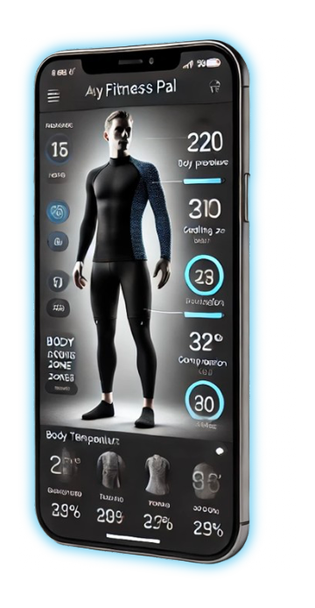
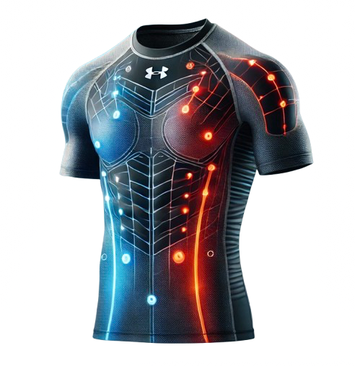
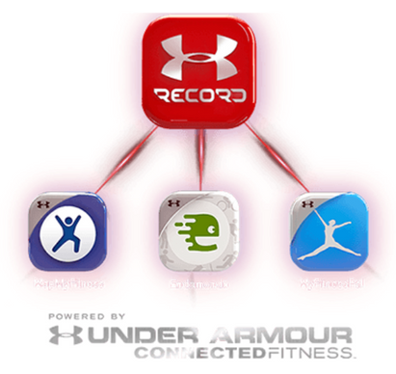
ADAPTIVE FABRIC OVERVIEW (1/2)
What It Is:
Fabric dynamic heating and cooling based on real-time body conditions.
Key Differentiators
Aiding muscle Recovery:
Dynamic cooling for post-workout inflammation reduction.
Heating functionality improves blood flow and flexibility.
Keeps blood flow steady during rest periods; reduces numbness and soreness.
Smart Compression:
Detects fatigue and alerts athletes to rest; provides cushioning to reduce injury risk.
Integration with Under Armour App
Real-time updates on heating, cooling, and compression.
Fatigue alerts and recovery insights for tailored user experience.
7
Notes:
Adaptive Fabric: Elevating Under Armour's Performance Technology Beyond Iso-Chill
Business Concept:
While Under Armour's Iso-Chill technology has focused on cooling athletes by passively dissipating heat, our proposed Adaptive Fabric concept pushes the boundaries of athletic apparel. Adaptive Fabric integrates heating and cooling capabilities, providing dynamic and personalized solutions for a variety of athletic needs, all based on real-time data and body conditions.
Key Differentiators of Adaptive Fabric Technology
1) Muscle Relaxation:
Adaptive Fabric offers both heating and cooling functionalities to enhance muscle relaxation. Post-exercise, the cooling feature is utilized to reduce inflammation and swelling, which is crucial for rapid post-workout recovery and prevention of muscle fatigue. After cooling, the heating functionality is activated to improve blood flow, reduce muscle stiffness, and further promote relaxation, allowing deeper recovery and minimizing soreness. The fabric's adaptability means it can switch dynamically between cooling and heating to meet the athlete's needs at any given time, optimizing recovery and flexibility.
2) Better Performance In Cold Conditions:
The heating functionality helps maintain muscle warmth during cold weather, which prevents muscle stiffness and ensures optimal flexibility. This is particularly critical for outdoor winter sports where maintaining muscle temperature directly impacts athletic performance.
3) Preventing Voidness and Maintaining Blood Flow:
For athletes experiencing extended periods of inactivity (e.g., sitting on the bench or resting during breaks), the heating function helps maintain steady blood flow to prevent voidness or numbness in the muscles. By keeping blood circulation optimal, Adaptive fabric ensures muscles remain primed for action whenever needed. Additionally, heating helps facilitate lactic acid removal post-exercise, reducing muscle soreness and aiding in faster recovery.
4) After-Match Muscle Recovery:
Adaptive Fabric provides targeted heat to muscle groups post-match, aiding in tension reduction and muscle relaxation. This targeted warmth allows for enhanced recovery, helping athletes feel refreshed and recover more quickly.
5) Smart Compression & Fatigue Prevention:
Beyond heating and cooling, Adaptive Fabric integrates smart compression technology. Using real-time data on fatigue, heart rate, and sweat detection, the fabric can alert wearers to slow down or take breaks to prevent fatigue. Additionally, adaptive clothing can provide extra cushion support to vulnerable areas, like the knees, reducing the risk of injury due to jerks or high impact.
Integration with Under Armour App: Athletes can access the Under Armour app to get real-time updates on the adaptive fabric's features, including personalized heating and cooling levels, fatigue alerts, and suggested recovery actions. This level of integration creates a smart, connected ecosystem that helps users make informed decisions to enhance performance and recovery.
Analytical Study of Adaptive Fabric Technology
Feasibility and Cost: The idea of adaptive fabric is technologically possible, but it requires advanced sensor integration, flexible heating elements, and a robust control system to operate effectively. Current research indicates that micro-heating elements and cooling patches can be embedded within fabrics, but the complexity means that the initial cost will be higher compared to traditional athletic apparel.
Cost Considerations: Adaptive fabrics will likely be positioned as a premium product due to the materials and technology involved. These garments will be more expensive to produce due to the integration of microcontrollers, sensors, heating/cooling elements, and machine learning algorithms to personalize the user's experience. However, the enhanced performance and recovery benefits justify the higher price for elite athletes and tech-savvy consumers.
Waterproof Capability: Yes, adaptive fabrics can be made waterproof or water-resistant through advanced coatings or waterproof membranes. This ensures that the integrated sensors and heating elements are protected from sweat and environmental moisture, making it practical for real-life use during outdoor activities or intense workouts.
Marketability: Given the increasing interest in personalized performance apparel, adaptive fabric has a promising market opportunity. The combination of dynamic temperature regulation, smart compression, and data-driven feedback provides a distinct value proposition that would appeal to professional athletes and fitness enthusiasts. The technology’s uniqueness will create a differentiator for Under Armour, pushing them ahead of competitors in terms of innovation.

Slide 8
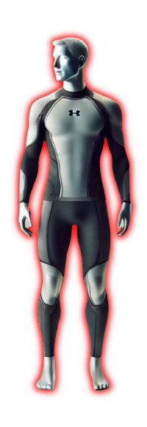
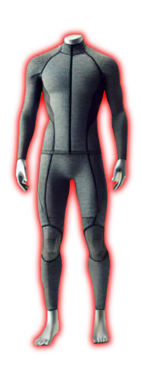
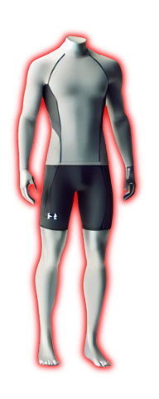
STRATEGIES TO ENGAGE MORE CUSTOMERS
1. Sponsorships in Major Sports
Partner with leagues and teams
Professional athletes
2. Collaborations with Health Organizations
Partner with WHO, sports clinics, and physiotherapists to highlight health benefits.
Position the product as essential for injury prevention and muscle health.
3. Digital Marketing and Influencer Campaigns
Targeted campaigns showcasing real-life use cases.
Testimonials from athletes emphasizing benefits over traditional apparel.
4. Early Adopter Program
Launch exclusive pre-release for fitness enthusiasts and elite athletes.
8
Notes:
Strategies to Engage More Customers
1) Sponsorships in Major Sports: To engage a larger audience and create visibility, Under Armour can pursue sponsorships in major sports events, such as football, baseball, and basketball games. By partnering with popular teams or leagues, Adaptive Fabric can gain exposure through athletes wearing the technology during high-profile events, showcasing the benefits of personalized heating and cooling for performance and recovery.
2) Collaborations with Health Organizations: Under Armour could also collaborate with health organizations like the World Health Organization (WHO), sports rehabilitation clinics, or professional physiotherapy associations to highlight the health benefits of adaptive clothing. By promoting the use of adaptive fabrics for injury prevention, enhanced recovery, and maintaining optimal muscle health, the brand can tap into the health-conscious market and build credibility.
3) Fitness and Wellness Partnerships: Collaborate with gyms, fitness centers, and wellness influencers to promote the Adaptive Fabric as a must-have for both professional athletes and everyday fitness enthusiasts. Demonstrations in fitness centers or endorsements from fitness trainers can help communicate the tangible benefits of the technology.
4) Digital Marketing and Influencer Campaigns: A targeted digital marketing campaign could be used to showcase real-life use cases, featuring professional athletes and fitness influencers. These campaigns could emphasize the personalized experience provided by Adaptive Fabric and its benefits over traditional apparel, including targeted heating, cooling, and compression for optimal performance and recovery.
5) Early Adopter Program: Launch an early adopter program to allow fitness enthusiasts, elite athletes, and technology fans to purchase and test the Adaptive Fabric technology early. This will help create buzz and gather feedback to refine the product before a larger rollout.

Slide 9
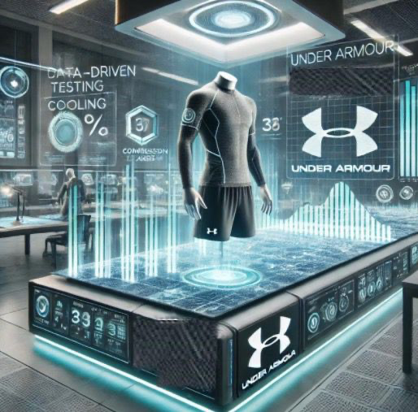
ORGANIZATIONAL CHANGES REQUIRED (1/2)
1. Innovation and Research & Development (R&D) Expansion
As adaptive fabric integrates technologies like sensors and machine learning, R&D must broaden its focus. Under Armour needs to combine textile engineering with data science and software development.
Example:
Create R&D teams for smart textiles and app integration, collaborate with tech companies, and provide upskilling in data analytics and IoT.
2. Product Development Lifecycle Transformation
The product development process must become more iterative, leveraging real-time data for continuous improvement.
Example:
Adopt agile development, use predictive analytics, and design personalized features based on user data.
3. New Business Models and Revenue Streams
The introduction of adaptive fabric opens up new business models, such as subscription services and data monetization.
Example:
Introduce subscription services, monetize wearable data, and form partnerships with fitness tech companies.
9
Notes:
1. Innovation and Research & Development (R&D) Expansion
Key Idea: The integration of technologies like sensors, machine learning, and IoT requires Under Armour’s R&D to evolve beyond traditional textile engineering to encompass advanced software and data science.
Actions:
Expand R&D Teams: Build dedicated teams for smart textiles and software integration to align fabric innovation with digital ecosystems.
Collaborate with Tech Companies: Partner with leading tech firms for expertise in machine learning, IoT, and app development to fast-track innovation.
Upskilling Initiatives: Provide existing employees with training in data analytics, AI, and IoT to create a workforce capable of supporting adaptive fabric innovations.
Challenges:
Balancing cost and speed of R&D expansion.
Maintaining alignment between textile and tech development cycles.
Opportunities:
Stay ahead in the smart apparel market by pioneering innovative products.
Leverage collaborative innovation to share R&D costs and risks.
2. Product Development Lifecycle Transformation
Key Idea: Transitioning to iterative and data-driven development processes allows for faster, user-centered innovation in adaptive fabrics.
Actions:
Adopt Agile Methodologies: Use an agile framework to accelerate product development cycles and allow for flexibility based on real-time data insights.
Use Predictive Analytics: Analyze customer data and usage patterns to anticipate needs, refine designs, and improve personalization.
Implement Prototyping and Testing: Regularly test prototypes in real-world conditions using consumer feedback to enhance product iterations.
Challenges:
Managing cross-functional teams in fast-paced agile environments.
Ensuring data quality and relevance for predictive models.
Opportunities:
Quickly respond to market demands and consumer feedback.
Enhance product quality and relevance through real-time improvement.
3. New Business Models and Revenue Streams
Key Idea: Adaptive fabric technology paves the way for innovative revenue models beyond traditional retail, focusing on digital and service-based income streams.
Actions:
Introduce Subscription Services: Offer access to premium features like enhanced app integration, advanced fabric settings, or fitness insights through a subscription model.
Monetize Wearable Data: Partner with analytics platforms to provide anonymized data insights to health or fitness industries.
Forge Partnerships: Collaborate with fitness tech companies (e.g., Fitbit, Garmin) to create integrated ecosystems that drive recurring revenue.
Challenges:
Addressing consumer privacy concerns when monetizing data.
Designing pricing models that align with customer expectations.
Opportunities:
Build long-term customer relationships through subscriptions.
Create competitive differentiation via ecosystem partnerships.

Slide 10
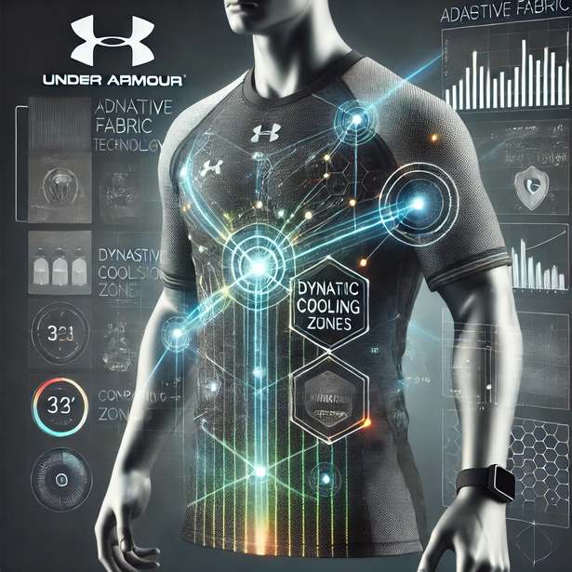
ORGANIZATIONAL CHANGES REQUIRED (1/2)
4. Marketing and Consumer Engagement
Marketing needs to shift to a personalized, data-driven approach to engage consumers more effectively.
Example:
Use data for targeted campaigns, enable social sharing, and integrate gamification in the app.
5. Supply Chain and Manufacturing Adjustments
The supply chain must be flexible and data-driven to meet the needs of adaptive fabric.
Example:
Implement predictive demand forecasting, use just-in-time manufacturing, and focus on sustainable fabrics.
6. Organizational Culture Shifts and Talent Acquisition
A culture of collaboration and innovation is essential, with a focus on recruiting tech experts for the adaptive fabric initiative.
Example:
Form cross-functional teams, encourage agility, hire a CTO, and recruit data scientists and IoT engineers.
10
Notes:
4. Marketing and Consumer Engagement
Key Idea: A shift to personalized, data-driven marketing is critical to connect with consumers and showcase the unique value of adaptive fabrics.
Actions:
Targeted Campaigns: Use consumer data for tailored advertising that emphasizes product personalization and performance benefits.
Social Sharing: Encourage users to share their fitness achievements or fabric insights through integrated social media tools, boosting word-of-mouth marketing.
Gamification: Add rewards, challenges, and achievements to the app to foster engagement and brand loyalty.
Challenges:
Balancing personalization with privacy regulations.
Creating engaging campaigns that resonate across diverse audiences.
Opportunities:
Build deeper consumer relationships through customized experiences.
Use gamification to increase app usage and brand affinity.
5. Supply Chain and Manufacturing Adjustments
Key Idea: The supply chain must adapt to support flexible and data-driven production processes tailored to adaptive fabric’s advanced requirements.
Actions:
Predictive Demand Forecasting: Leverage analytics to anticipate production needs and minimize overproduction or stock shortages.
Just-In-Time Manufacturing: Adopt lean manufacturing processes to reduce waste and meet variable demand efficiently.
Focus on Sustainability: Prioritize eco-friendly materials and methods to align with growing consumer preferences for sustainable products.
Challenges:
Ensuring reliability of advanced materials and tech components.
Balancing sustainability goals with cost efficiency.
Opportunities:
Improve efficiency and profitability through streamlined operations.
Enhance brand reputation with sustainable practices.
6. Organizational Culture Shifts and Talent Acquisition
Key Idea: Fostering a culture of collaboration and innovation is essential to attract and retain the technical talent required for adaptive fabric success.
Actions:
Cross-Functional Teams: Establish teams combining expertise in textiles, software, data science, and IoT to ensure seamless collaboration.
Encourage Agility: Promote an adaptive, fast-moving organizational culture to support dynamic innovation cycles.
Recruit Technical Talent: Hire a Chief Technology Officer (CTO) and experts in AI, data science, and IoT to lead the adaptive fabric initiative.
Upskill Current Workforce: Provide learning opportunities in relevant technologies to prepare the existing workforce for the initiative.
Challenges:
Attracting top talent in a competitive job market.
Aligning traditional and digital teams under a unified culture.
Opportunities:
Build a forward-thinking organization ready for future innovations.
Drive faster, more effective innovation through interdisciplinary collaboration.

Slide 11

RISKS AND UNCERTAINITIES
1. Market Risks: Gaining consumer trust in new technology may be challenging, and privacy concerns around health data could deter potential users. Additionally, catering to different needs could complicate production and increase costs.
2. Operational Risks: Securing a consistent supply of materials and integrating sensors into fabric could create manufacturing hurdles. High production costs may also make the product less affordable for the mass market.
3. Regulatory and Ethical Risks: Compliance with varying regional health and safety standards can be complex, and the use of biometric data may raise privacy and consent concerns. Environmental impact from production could also damage the brand's image.
4. Uncertainties in Product Development: Consumer preferences may shift quickly, making it difficult to predict long-term market appeal. The durability and real-world effectiveness of adaptive fabrics are still uncertain, as is their actual performance.
5. Financial Risks: Significant investment in R&D may not lead to immediate returns, and the risk of competitors quickly developing similar technologies could impact profitability.
11
Notes:
1. Market Risks
Key Idea: Building consumer trust in a new technology like adaptive fabric is essential but challenging due to privacy and adoption barriers.
Challenges:
Consumer Skepticism: Many consumers might be wary of trying a product that collects biometric data, fearing misuse or security breaches.
Customization Complexity: Catering to diverse user needs (e.g., athletic performance, casual wear) may require varying designs, increasing production complexity.
Price Sensitivity: Advanced features may result in higher costs, potentially alienating budget-conscious consumers.
Opportunities to Mitigate:
Transparent communication about data security and benefits.
Offer entry-level products to attract a broader audience.
Leverage partnerships with trusted tech brands to enhance credibility.
2. Operational Risks
Key Idea: The integration of sensors and IoT components into fabrics introduces manufacturing challenges, alongside cost pressures.
Challenges:
Material Supply: Securing specialized components like sensors and conductive fabrics could lead to supply chain bottlenecks.
Production Integration: Manufacturing processes must be updated to include advanced tech, requiring significant investment in new equipment and training.
Cost Management: Balancing high-tech integration with affordability for mass-market appeal is a critical hurdle.
Opportunities to Mitigate:
Establish long-term contracts with reliable suppliers.
Gradually scale production to control initial costs.
Explore automation to reduce manufacturing inefficiencies.
3. Regulatory and Ethical Risks
Key Idea: Adhering to legal and ethical guidelines around health data and sustainable production can be complex and region-specific.
Challenges:
Health and Safety Standards: Adaptive fabric products must comply with regulations across multiple markets, potentially delaying launches.
Data Privacy Concerns: Collecting biometric data could raise ethical questions about consent, security, and usage, especially with GDPR and similar laws.
Environmental Impact: High-tech materials might increase the carbon footprint unless offset by sustainable practices, risking reputational damage.
Opportunities to Mitigate:
Collaborate with legal experts to navigate compliance.
Develop transparent data policies and user-consent frameworks.
Invest in eco-friendly production processes and materials.
4. Uncertainties in Product Development
Key Idea: Shifting consumer preferences and untested adaptive fabric features pose significant risks to long-term product success.
Challenges:
Durability Concerns: Sensors and tech components must withstand frequent washing and wear without degrading functionality.
Market Appeal: Consumer preferences for smart textiles are still evolving, making it hard to predict demand.
Iterative Design Risks: The iterative development process may lead to delays or increased costs if prototypes fail to meet expectations.
Opportunities to Mitigate:
Conduct extensive beta testing with target audiences.
Build modular designs to allow for tech upgrades without replacing the entire garment.
Monitor market trends and adjust features accordingly.
5. Financial Risks
Key Idea: The high cost of R&D and the competitive nature of the wearable tech market pose risks to profitability.
Challenges:
R&D Costs: Significant investment in integrating textiles with advanced technology may not yield immediate returns.
Competitor Activity: Rivals could replicate or improve on adaptive fabric technology, capturing market share.
Scalability Issues: Limited initial production might hinder revenue growth and market penetration.
Opportunities to Mitigate:
Secure strategic partnerships to share R&D costs and risks.
Focus on patents and intellectual property to safeguard innovations.
Start with small-scale launches to minimize upfront financial exposure.

Slide 12



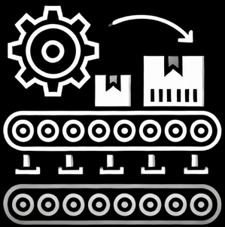
CUSTOMER ACCEPTABILITY TOWARDS ADAPTIVE FABRIC
Customer Satisfaction:
Conduct surveys and analyze customer feedback on adaptive products
- Customer Information Gathered on Point of Sale
- Survey
Questions : 5-point Likert Scale
- Do you prefer the adaptive fabric product line?
- Would you suggest it to other people?
Track Net Promoter Scores (NPS) to measure loyalty
-Customers likely to promote the product
Adoption Rate:
Understanding the target audience
Measure the percentage of customers purchasing adaptive fabric products
12
Notes:
• How to Measure Success:
1. Customer Satisfaction:
• Conduct surveys and analyze customer feedback on adaptive products.
The actual success of the product not only depends on bringing the idea into reality, but also considering the aspect that how the consumers perceive the product. To get an idea of how the product is responding in the market, customer feedback is important. To do so, A short survey would be sent to customers how have purchased the product, that would be tracked at the POS, with required contact details so that they could fill out the form.
• Track Net Promoter Scores (NPS) to measure loyalty.
These surveys would further be analyzed, to get the understanding of how much consumers are likely to become a promoter of this new product, which would further give a predictive aspect of the expected sales, with these customers being the promoter of the product by word of mouth (which could either be organic and on an online purchase, be amplified too).
2. Adoption Rate:
• Understanding the target audience:
To get an understanding of the adoption rate, it is important in enquire about the current target audience of the brand. This audience would include the loyal customers of the brand along with any potential new customers that would be willing to purchase the new product. This could be done through prior data of customers who already exist and are repeat customers of Under Armour, on both physical and online platforms. Besides this, for any new customers, to acknowledge the products adoptability, they should fall in the criteria of a customer that would provide a positive WOM which would be determined by their survey.
• Measure the percentage of customers purchasing adaptive fabric products.
Adoption Rate (%) = (Total target customer base/Number of customers purchasing adaptive fabric products)×100

Slide 13
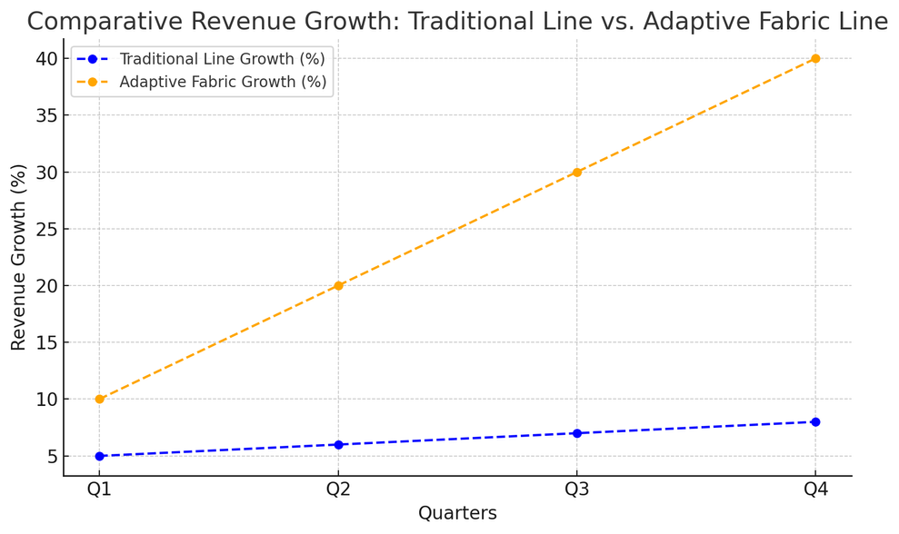

IS THE PRODUCT PROFITABLE?
1. Revenue Growth
Revenue generated by new product line and similar traditional line products.
Does introduction of new product improve the year-on-year growth rate.
2. Operational Efficiency
Predictive analytics would aid in reducing inventory cost, by predicting the demand of products
3. Optimize Resource Utilization
Also focusing on sustainability, monitor efficient use of raw material and automation in manufacturing to improve labour efficiency
13
Notes:
Revenue Growth:
• Analyze quarterly revenue increases attributed to new product lines.
Is there any visible growth seen in revenue comparing it to quarterly sales of the products. But to have a better idea. We need too also compare the quarterly sales of previous years which generated revenue from only the traditional line and considering the growth rate of prior years’ revenue, was there an increase in growth rate visible by the introduction of this new product line.
• Assess profit margins on adaptive fabric products compared to traditional lines.
Another aspect to measure the success of the product is viewing whether this product is profitable or not. This would take in account the cost of producing this new product line against the revenue it generated. This measure would be compared to the products that are somewhat similar from the existing traditional product line to consider the comparison to be fair. For example, the products for gym wear from the traditional product line and the new product line would be compared in terms of profit they generate.
Operational Efficiency:
• Measure Reductions in Inventory Costs and Waste
Reducing inventory costs and waste begins with dynamic inventory management powered by real-time sales data and predictive analytics. By forecasting demand accurately, Under Armour can avoid overproduction and minimize excess inventory. Unsold items can be repurposed into high-performance adaptive garments using advanced recycling techniques, contributing to sustainability efforts. Metrics such as inventory turnover ratio, waste reduction rates, and cost savings from recycling can quantify the efficiency and cost-effectiveness of these measures.
Optimize Resource Utilization
• Resource utilization is critical for operational efficiency, and automation plays a pivotal role. Integrating machine learning and automated systems can significantly reduce labor hours and production waste while increasing the use of raw materials effectively. Monitoring the percentage of materials utilized, labor efficiency, and savings from automation ensures that resources are deployed optimally. These improvements not only enhance efficiency but also align with the goal of producing high-quality adaptive clothing.
• Focus on Sustainable Supply Chains
Sustainability is at the core of Under Armour’s adaptive clothing line, emphasizing reduced waste and eco-friendly practices. Transforming old garments into durable, high-performance adaptive products support a circular economy while lowering production costs. Tracking the carbon footprint of operations and the circularity rate of materials ensures accountability in sustainability goals. These practices highlight the brand’s commitment to responsible innovation while setting a benchmark in sustainable fashion.

Slide 14

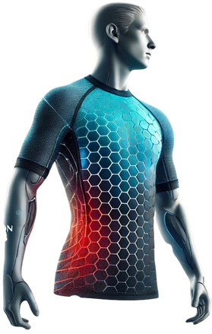
THE PREDICTIVE FUTURE OF UNDER ARMOUR
Vision:
Under Armour leads the industry by integrating predictive analytics into adaptive fabric technology, redefining athletic performance and customer experience.
Strategic Goals:
Expand adaptive fabrics to footwear, outerwear, and accessories.
Strengthen partnerships with fitness platforms for real-time data insights.
Drive R&D to advance adaptive materials and biofeedback integration.
Customer Impact:
Personalized athletic gear that adjusts in real-time to activity and environment, delivering unparalleled comfort and performance.
Solidify Under Armour as the go-to brand for data-driven, innovative sportswear.
By leveraging predictive analytics, Under Armour is not just enhancing athletic wear—it’s redefining the future of performance and innovation, starting with adaptive fabrics.
14
Notes:
Vision
Under Armour’s future lies in leading the sportswear industry through adaptive, data-driven innovation. By integrating predictive analytics into its core operations, Under Armour aims to:
• Revolutionize athletic wear with adaptive fabrics that personalize comfort and performance in real-time. These fabrics, powered by advanced predictive insights, will evolve with the user’s needs—whether they’re training for a marathon, recovering after a workout, or performing in extreme climates.
• Move beyond its traditional role as an apparel manufacturer to become a tech-enabled sportswear brand that seamlessly blends physical products with digital ecosystems. Adaptive fabrics will serve as the cornerstone of this transformation, showcasing the potential of data-backed design.
Long-Term Goals
1. Expand Predictive Analytics to All Product Lines:
• Extend the adaptive fabric concept into footwear, accessories, and outerwear:
• Footwear that adjusts cushioning or support based on running intensity.
• Outerwear that modifies insulation depending on outdoor temperatures.
• Accessories, such as gloves or hats, that adapt compression and thermal properties for individual comfort.
• Develop a complete ecosystem of products that interact and adjust dynamically, creating a cohesive experience for customers.
2. Strengthen Partnerships with Fitness Platforms:
• Build stronger integrations with apps like MyFitnessPal and MapMyRun to:
• Collect detailed user data, such as activity levels, workout types, and biometric metrics, in real-time.
• Enhance product recommendations tailored to specific user profiles.
• Collaborate with wearable technology companies to expand data collection capabilities and integrate predictive insights directly into the apparel.
3. Drive Research & Development:
• Continue investing in R&D for innovative materials that expand the capabilities of adaptive fabrics.
• Explore biofeedback technology, where fabrics could interact with users’ physiological signals (e.g., heart rate, sweat levels) to optimize performance further.
Customer Impact
1. Deeply Personalized Athletic Experiences:
• Adaptive fabrics will act like a second skin, responding to environmental and physiological changes to provide unmatched comfort and performance.
• For example:
• A cyclist riding uphill in warm conditions will experience instant cooling in targeted zones, while compression adapts to relieve muscle fatigue.
• A yoga enthusiast wearing adaptive recovery gear will benefit from gentle compression that aligns with their body’s recovery needs.
2. Enhanced Brand Loyalty through Real-Time Innovation:
• By leveraging predictive analytics, Under Armour ensures customers always have access to the most advanced and personalized gear on the market.
• Products won’t just meet current needs—they’ll anticipate future challenges, strengthening Under Armour’s position as an essential partner in every athlete’s journey.
3. Competitive Edge:
• With adaptive fabric leading the charge, Under Armour will set a new standard for innovation in the sportswear industry.
• Continuous innovation through real-time data collection and predictive modeling ensures Under Armour remains one step ahead of competitors like Nike and Adidas.
By leveraging predictive analytics, Under Armour is not just enhancing athletic wear—it’s redefining the future of performance and innovation. Adaptive fabric is the foundation of this transformation, exemplifying how data-driven design can revolutionize the way athletes interact with their gear. As Under Armour continues to innovate, it will lead a new era of sportswear, where products aren’t just worn—they adapt, evolve, and perform alongside the athlete.

Slide 15
BIBLIOGRAPHY (1/2)
1. Harvard Business School. “Under Armour’s Transition to a Data-Driven Fitness Lifestyle Company: Will It Pay Off?” Harvard Business School Digital Initiative. Accessed November 16, 2024. https://d3.harvard.edu/platform-digit/submission/under-armours-transition-to-a-data-driven-fitness-lifestyle-company-will-it-pay-off/.
2. Bernard Marr. “How Nike Is Using Data to Sell Directly to Customers.” Bernard Marr & Co., Accessed November 16, 2024. https://bernardmarr.com/how-nike-is-using-data-to-sell-directly-to-customers/.
3. Strategy Insights. “Top 10 Under Armour Competitors and Alternatives.” BStrategy Insights. Accessed November 16, 2024. https://www.bstrategyinsights.com/top-10-under-armour-competitors-and-alternatives/.
4. Industry Dive. “How Under Armour Uses Predictive Analytics to Build a Resilient Supply Chain.” Industry Dive. Accessed November 16, 2024. https://resources.industrydive.com/under-armour-predictive-analytics-resilient-supply-chain.
5. Amplitude. “Under Armour Case Study.” Amplitude. Accessed November 16, 2024. https://amplitude.com/case-studies/under-armor.
6. Invezz. “Under Armour Shares Surge 25% as Company Raises Profit Forecast on Cost-Saving Strategies.” Invezz. Published November 7, 2024. https://invezz.com/news/2024/11/07/under-armour-shares-surge-25-as-company-raises-profit-forecast-on-cost-saving-strategies/.
15

Slide 16
BIBLIOGRAPHY (2/2)
7. Investopedia. “Adidas vs. Nike vs. Under Armour: Which Is Better?” Investopedia. Accessed November 16, 2024. https://www.investopedia.com/articles/markets/012616/adidas-vs-nike-vs-under-armour-which-2016-nkeua.asp.
8. CSIMarket. “Under Armour Net Revenues and Market Share.” CSIMarket. Accessed November 16, 2024. https://csimarket.com/stocks/competitionSEG2.php?code=UA.
9. Under Armour. “Iso-Chill Technology.” Under Armour Official Website. Accessed November 16, 2024. https://www.underarmour.com/en-us/c/technology/iso-chill/.
10. InterObservers. “Under Armour Competitors.” InterObservers. Accessed November 16, 2024. https://interobservers.com/under-armour-competitors/.
11. Doe, John. Consumer Trust in Emerging Technologies: Challenges and Solutions. TechPress, 2023.
12. Smith, Jane, et al. “Supply Chain Challenges for Smart Textiles.” Journal of Advanced Manufacturing, vol. 15, no. 4, 2023, pp. 102-117.
13. Brown, Emily. “Privacy and Consent Issues in Wearable Technologies.” Technology and Society Review, vol. 10, no. 2, 2022, pp. 85-96.
14. Green, Michael. Adapting to Change: Innovation in Consumer Goods. Future Trends Publishing, 2023.
15. Patel, Rajiv. “The Cost of Innovation: R&D and Market Risks in Technology-Driven Industries.” Business Horizons Quarterly, vol. 8, no. 1, 2023, pp. 45-62.
16

